Slide 1
Emparejamiento Aproximado entre Estudiantes y Tutores en las Intervenciones Educativas de la Fundación Ayudinga
Sustentación del Trabajo de Graduación para optar por el título de Licenciado en Ingeniería en Sistemas de Información
Autor: Johel Heraclio Batista Cárdenas | 8-914-587
Asesor: Víctor López Cabrera, MsC.
Universidad Tecnológica de Panamá
Facultad de Ingeniería en Sistemas Computacionales

Slide 2


01
#PilandoAndo
Objetivo: Diseñar y poner a prueba un sistema web basado en los modelos pedagógicos de Estilos de Aprendizaje y Estilos de Enseñanza, así como en la Teoría del Emparejamiento, que facilite un emparejamiento aproximado entre Estudiantes y Tutores en #PilandoAndo, el programa de intervenciones educativas masivas de la Fundación Ayudinga, maximizando la eficacia de estas.

Slide 3
Sobre #PilandoAndo
Tutorías Masivas y Libres de Matemáticas
Formato
Estudiantes entre 16-20 años que deseen hacer el examen de admisión
Público Objetivo
Contexto
Convocatoria a través de las redes sociales de la @ayudinga y @canaldepanama
Promoción
Jupiter is a gas giant and the biggest planet in the Solar System
Financiamiento

Slide 4
Reviewing concepts is a good idea
Mars
Venus
Neptune
Mars is actually a very cold place
Venus has extremely
high temperatures
Neptune is the farthest planet from the Sun
Mercury
Saturn
Jupiter
Mercury is the closest planet to the Sun
Saturn is a gas giant with several rings
Jupiter is the biggest planet of them all

Slide 5
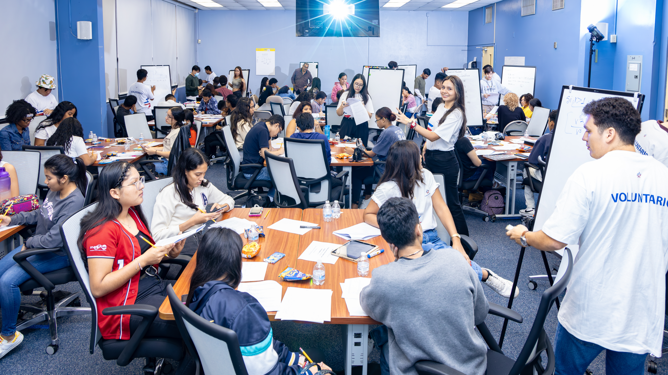
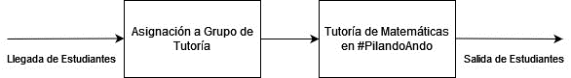
Tutorías de Matemáticas Libres y Gratuitas
Estado Previo del Sistema
Foto Cortesía: Niko Kosmas, Oficina de Asuntos Corporativos, Canal de Panamá

Slide 6

A picture always reinforces the concept
Images reveal large amounts of data, so remember: use an image instead of a long text. Your audience will appreciate it
Tutorías de Matemáticas Libres y Gratuitas
Foto Cortesía: Niko Kosmas, Oficina de Asuntos Corporativos, Canal de Panamá

Slide 7
02
Metodología y Diseño del Experimento

Slide 8
Metodología
Mercury is the closest planet to the Sun and the smallest one
Type of data
Venus has a beautiful name and is the second planet from the Sun
Motives
Mercury
Mars is full of iron oxide dust, which gives the planet its reddish cast
Data collection
Jupiter is a gas giant and the biggest planet in the Solar System
Sampling

Slide 9
Purpose statement
What about Mercury?
Mercury is the closest planet to the Sun and the smallest one in the Solar System. The planet’s name has nothing to do with the liquid metal
What about Venus?
Venus has a beautiful name and is the second planet from the Sun. It’s terribly hot and its atmosphere is extremely poisonous
What about Jupiter?
Jupiter is a gas giant and the biggest planet in the Solar System. It's the fourth-brightest object in the sky. It was named after a Roman god

Slide 10
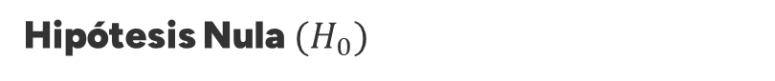
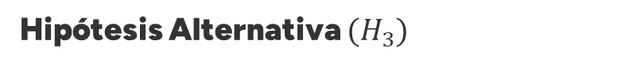
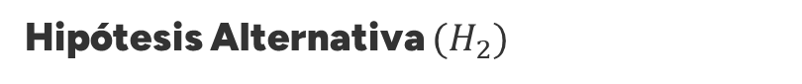

Hipótesis de Investigación
Hipótesis Nula $(H_{0})$
No hay diferencia en la efectividad de los emparejamientos entre el algoritmo de Gale-Shapley y los aleatorios en #PilandoAndo.
Hipótesis Alternativa $(H_{1})$
El algoritmo de Gale-Shapley logra emparejamientos más compatibles que los aleatorios en #PilandoAndo.
Hipótesis Alternativa $(H_{2})$
El algoritmo de Gale-Shapley mejora la concordancia de estilos de aprendizaje y enseñanza en comparación con emparejamientos aleatorios.
Hipótesis Alternativa $(H_{3})$
El algoritmo de Gale-Shapley es más eficiente en formar grupos completos y compatibles en #PilandoAndo que los emparejamientos aleatorios.

Slide 11
Awesome words

Slide 12
04
Modelado Matemático del Emparejamiento

Slide 13
Current situation & problems statement
Current situation
01
02
03
Jupiter is a gas giant and the biggest planet in the Solar System. It's the fourth-brightest object in the night sky. It was named after the Roman god of the skies and lightning
Earth
Mars
Mercury
Earth is the third planet from the Sun and has life
Despite being red, Mars is actually a cold place
Mercury is the smallest planet in the Solar System
Problems

Slide 14
05
Análisis de Resultados

Slide 15
Reviewing concepts is a good idea
Mars
Venus
Neptune
Mars is actually a very cold place
Venus has extremely
high temperatures
Neptune is the farthest planet from the Sun
Mercury
Saturn
Jupiter
Mercury is the closest planet to the Sun
Saturn is a gas giant with several rings
Jupiter is the biggest planet of them all

Slide 16
05
Conclusiones y Trabajos Futuros

Slide 17
Theoretical framework
Theoretical framework
Key terms | Relevant theories | Our framework
Mercury is small Earth harbors life Jupiter is big | Theory 1 | Venus has a beautiful name and is the second planet from the Sun. It’s very hot
 | Saturn is a gas giant and has rings. It’s composed mostly of hydrogen and helium
 | Theory 2
 | Neptune is the farthest planet from the Sun in Solar System and also an ice giant

Slide 18
Analysis & development
Phase 01
Phase 02
Mercury is the closest planet to the Sun and the smallest one in the Solar System—it’s a bit larger than the Moon
Jupiter is a gas giant, the biggest planet in the Solar System and the fourth-brightest object in the night sky
Neptune is the farthest planet from the Sun. It's also the fourth-largest planet by diameter in the Solar System
Venus has a beautiful name and is the second planet from the Sun. It’s terribly hot—even hotter than Mercury
Saturn is a gas giant and has several rings. This planet is composed mostly of hydrogen and helium
Earth is the third planet from the Sun and the only one that harbors life in the Solar System

Slide 19
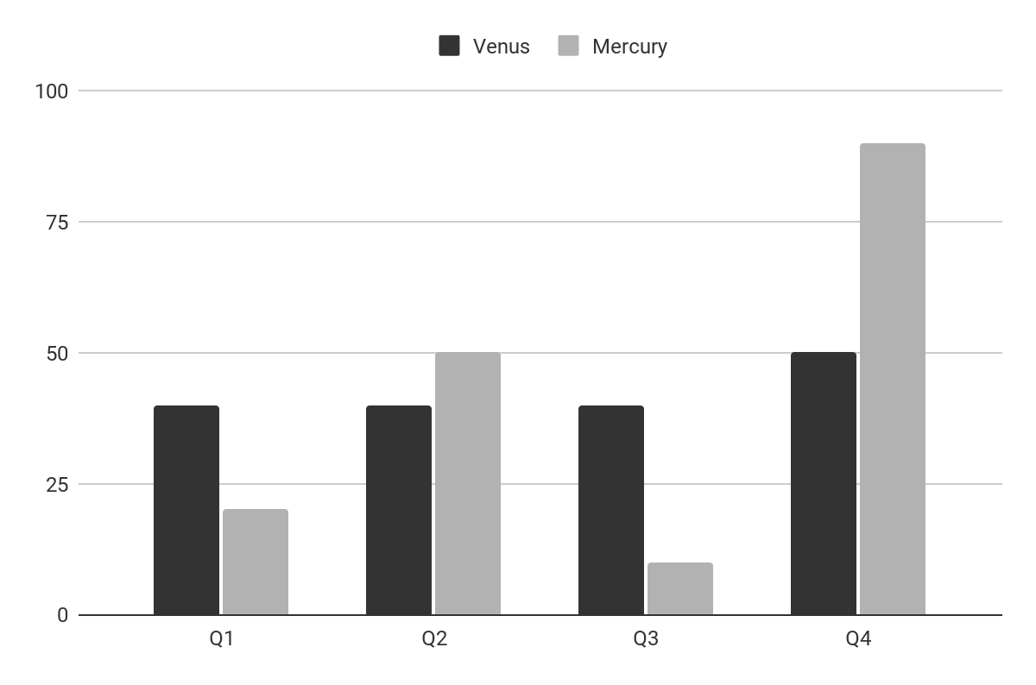
Analysis & development
Mercury is the closest planet to the Sun and the smallest one in the Solar System The planet’s name has nothing to do with the liquid metal
The Sun is the star at the center of the Solar System
Jupiter is the biggest planet in the entire Solar System
Saturn is composed mostly of hydrogen and helium
Venus
Mercury
Venus has a beautiful name
Mercury is quite a small planet
Follow the link in the graph to modify its data and then paste the new one here. For more info, click here

Slide 20
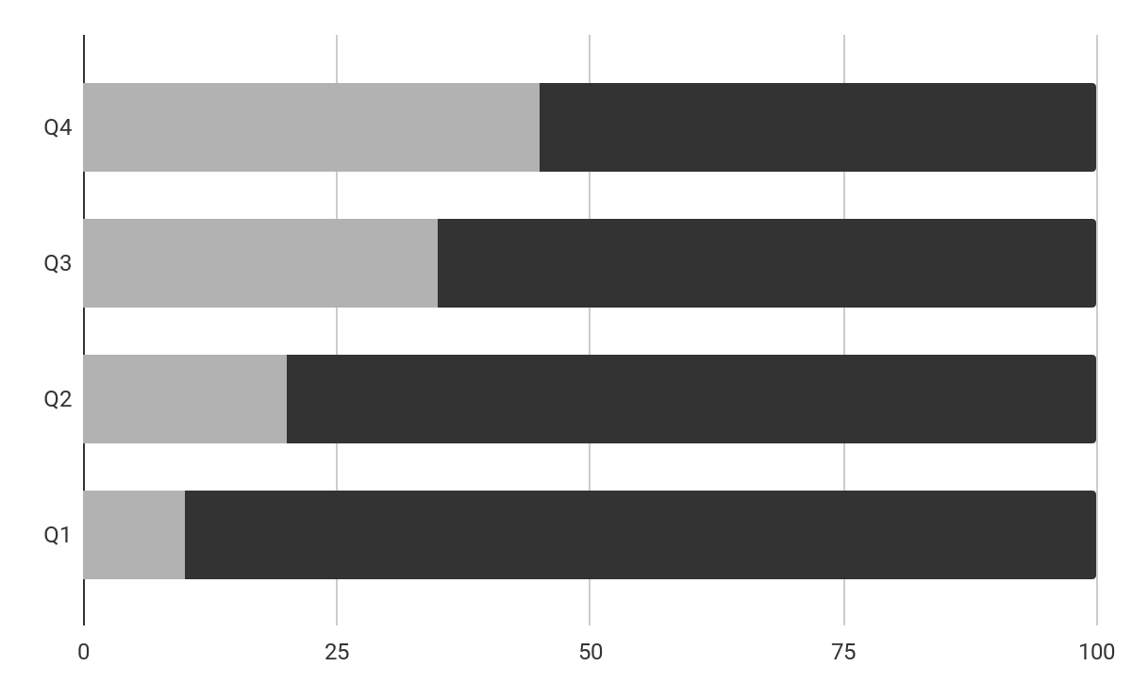
Analysis of the results
Mercury
Venus
Mercury is quite a small planet
Venus has a beautiful name
Mars
50%
Despite being red, Mars is a planet very cold
Follow the link in the graph to modify its data and then paste the new one here. For more info, click here

Slide 21
Discussion
Mars & Earth
Discussion 1
Despite being red, Mars is actually a cold place. It's full of iron oxide dust, which gives the planet its reddish cast. Earth is the third planet from the Sun and the only one that harbors life in the Solar System. This is where we all live:
Ceres is located in the main asteroid belt
The Moon is Earth’s natural satellite
Neptune is very far away from us
Pluto is now considered a dwarf planet
Mercury is the closest planet to the Sun and the smallest one in the Solar System. It’s bit larger than the Moon
Discussion 2
Venus has a beautiful name and is the second planet from the Sun. Venus is a lot hotter than Mercury

Slide 22
Conclusions
Mars
Venus
Despite being red, Mars is actually a cold place. It’s full of iron oxide dust
Venus has a very beautiful name and is the second planet from the Sun
Mercury
Neptune
Mercury is the closest planet to the Sun and the smallest one in the Solar System
Neptune is a ig planet. It is the fourth-largest planet by diameter in the Solar System

Slide 23
Icon pack

Slide 24
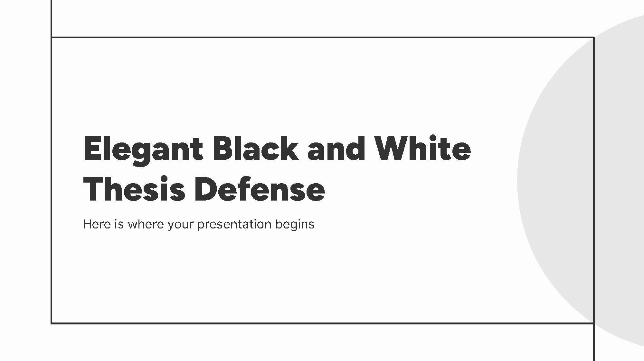

Sistema de Gestión Educativa | #PilandoAndo
You can replace the images on the screen with your own work. Just right-click on them and select “Replace image”

Slide 25

¡Gracias por su Atención!
Universidad Tecnológica de Panamá
Facultad de Ingeniería en Sistemas Computacionales
Correspondencia a: Johel Heraclio Batista Cárdenas
johel.batista@utp.ac.pa
+507 6920-4843
fisc.utp.ac.pa
Licencia Creative Commons Atribución-NoComercial 4.0 Internacional (CC BY-NC 4.0 DEED)

Slide 26
Fonts & colors used
This presentation has been made using the following fonts:
Figtree
(https://fonts.google.com/specimen/Figtree)
Hanken Grotesk
(https://fonts.google.com/specimen/Hanken+Grotesk)
#333333
#fdfdfd
#e8e7e7
#b2b2b2
#777777

Slide 27
...and our sets of editable icons
You can resize these icons without losing quality.
You can change the stroke and fill color; just select the icon and click on the paint bucket/pen.
In Google Slides, you can also use Flaticon’s extension, allowing you to customize and add even more icons.

Slide 28
Educational Icons
Medical Icons

Slide 29
Business Icons
Teamwork Icons

Slide 30
Help & Support Icons
Avatar Icons

Slide 31
Creative Process Icons
Performing Arts Icons

Slide 32
SEO & Marketing Icons

